Slide 1
Graph Autoencoder-Based Trust and Poisoning Detection for Federated Wireless Edge Networks
Team Member
2520040073-S.Prabhu
2520040090-P.Manikanth
2520040100-L.Gunashekar

Slide 2
Introduction
Federated Learning (FL) allows multiple devices to train a shared model without sharing their raw data. However, malicious clients may send poisoned updates that affect model performance.
Our project uses a Graph Autoencoder (GAE) to detect suspicious clients by analyzing their model updates and relationships. It creates a similarity graph, identifies unusual behavior using anomaly scores, and calculates trust scores for clients. The system uses the MNIST dataset, a CNN model, Federated Averaging (FedAvg), and label-flipping attacks. The main goal is to detect malicious clients and improve the security and reliability of federated learning.

Slide 3
Problem Statement
In federated learning, multiple edge devices train a common model. Some devices may be malicious and send poisoned updates that can affect the global model. Our project uses a Graph Autoencoder to analyze the behavior of clients and identify suspicious clients using anomaly and trust scores.
Objectives:
Build a federated learning environment with multiple clients.
Simulate malicious clients using poisoning attacks.
Extract client model-update behavior.
Construct a similarity graph between clients.
Apply a Graph Autoencoder to learn client patterns.
Calculate anomaly and trust scores.

Slide 4
Proposed Methodology
Federated Learning (FL) – provides the collaborative learning environment where multiple edge clients train a common model without sharing their raw data
Graph Autoencoder (GAE) – analyzes the behavior of the clients to detect abnormal/malicious clients using reconstruction error, anomaly scores, and trust scores.
Federated Averaging -is an algorithm used in Federated Learning to combine the models trained by different clients.

Slide 5
Workflow of Project
1
Federated Learning
Multiple edge clients participate in collaborative training
5
Client Similarity Graph
Relationships between clients are created based on their
model-update similarity
2
Local Training
Each client trains the model using its own data.
6
Graph Autoencoder (GAE)
Learns client patterns and identifies abnormal behavior.
3
Poisoning Attack
Some clients send poisoned/malicious model updates.
7
Anomaly & Trust Score
Measures how abnormal and trustworthy each client .
4
FedAvg
The server combines the local client models to create the global model.
8
Malicious Client Detection
Identifies suspicious clients

Slide 6
Simulation of Project
The proposed system is simulated as a federated wireless edge network consisting of multiple edge clients. Each client performs local model training using its own portion of the MNIST dataset. Some clients are considered malicious clients and perform a label-flipping poisoning attack.
The trained client models are aggregated using Federated Averaging (FedAvg) to obtain the global model. The client model updates are then analyzed to identify relationships between clients. A client similarity graph is constructed, and a Graph Autoencoder (GAE) is used to learn the normal behavior and relationships among clients.
Finally, anomaly scores and trust scores are calculated to identify suspicious or potentially malicious clients

Slide 7
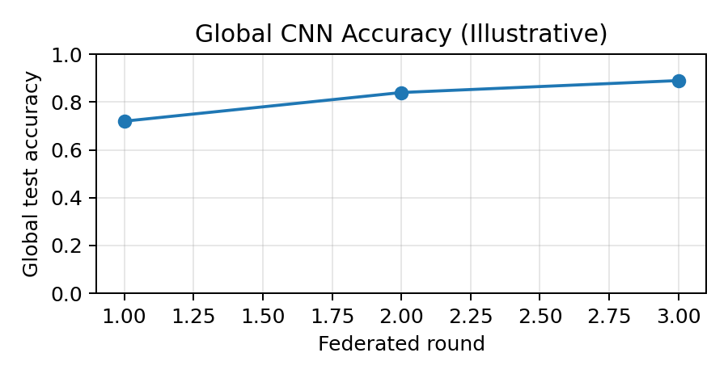
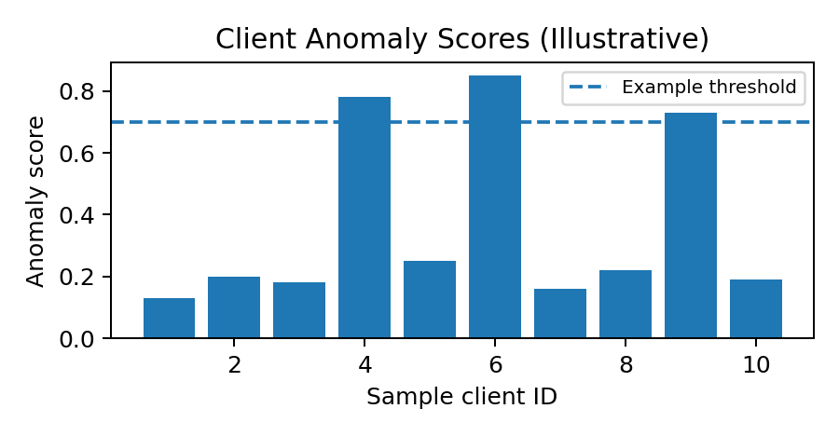
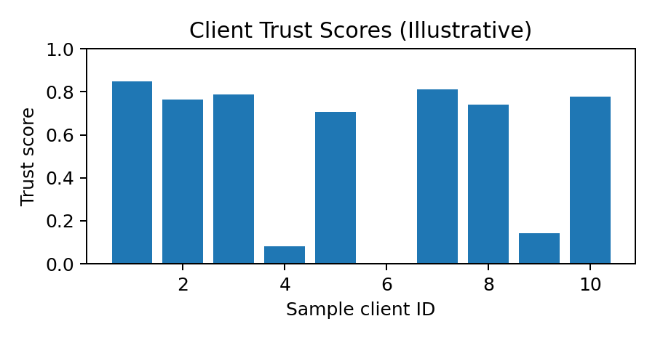
Experimental Results
What the outputs show
Accuracy graph: global CNN test accuracy across federated rounds.
Anomaly graph: clients above the detection threshold are flagged as suspicious; trust score decreases as anomaly increases.

Slide 8
CURRENT PROGRESS
• Federated Learning environment created
• CNN model implemented for MNIST classification
• Label-flipping poisoning attack simulated
• FedAvg aggregation and client updates implemented
• Client similarity graph and GAE detection implemented
• Anomaly and trust scores calculated

Slide 9
Conclusion
This project proposes a Graph Autoencoder (GAE)-based approach to detect poisoning attacks in Federated Learning by analyzing client model updates, similarity graphs, anomaly scores, and trust scores. The experimental results demonstrate the feasibility of the proposed approach, but further improvements are needed to increase detection accuracy, reduce false positives, and enhance the security and reliability of federated wireless edge networks.

Slide 10
THANKS

